Slide 1
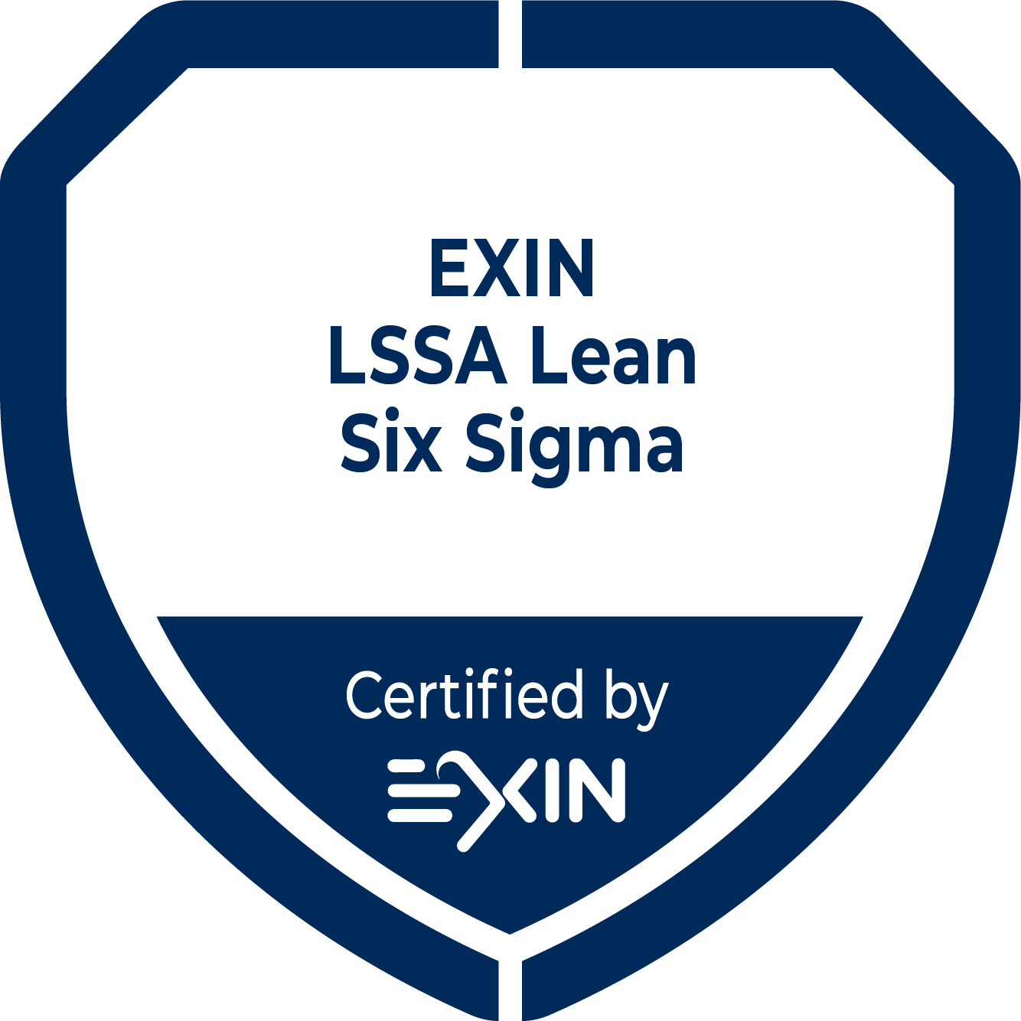
DMADV Lean Six Sigma Review Template
202410

Slide 2
DMADV DfSS review template
Project title: <Title>
Project Type: Design for Six Sigma
Organization: <Name organization>
Project manager: <Name Belt>
Belt level: <Green Belt / Black Belt>
Date: -
Revision: v6.6

Slide 3
Introduction
Objective review template
To submit a DfSS project for certification by the LSSA.
To present the project in your own organization.
Guidelines:
The approach taken must be easy to follow for people with knowledge of Lean and/or Six Sigma.
Avoid internal jargon.
Explain abbreviations when you use it for the first time.
Questions and guidelines can be found in the speaker notes.
At the end of each phase is a checklist to verify whether the right things have been paid attention to.
Conclusions and decisions must be clear.
As a guideline, follow this template closely when you submit the project. Do not add more than 5 slides.
Please delete this slide before submitting.

Slide 4
Introduction
DMADV roadmap
  Define 1 Define project & Determine project Scope
  2 Determine functional requirements
  3 Plan and document project
  Measure 4 Translate into technical requirements
  5 Establish objectives
  6 Evaluate measurement system
  Analyze 7 Develop concept design
  8 Identify potential influence factors
  9 Develop Y=f(X) function
  Design 10 Determine optimum design
  11 Prototyping / concept
  12 Design validation plan
  Verify 13 Design validation
  14 Close out project

Slide 5
DEFINE
1 – Define project & determine project scope
Problem description
.
SPECIFIC
MEASURABLE
ATTAINABLE
RELEVANT
TIMELY
Objective
.
Notes:
Description of problem
Describe the problem. Why is the problem a problem?
Use techniques such as 5W2H; IS-IS NOT.
If necessary, add a photo of the product if the problem can be made visible.
Note: the problem description does not contain any solutions.
Objective
Describe as concretely as possible what you want to achieve.
Together, the problem description and objective must be formulated SMART.

Slide 6
DEFINE
1 – Define project & determine project scope
KPI/target:
In Scope:
Out of Scope:
Deliverables:
Hard Benefits:
Soft Benefits:
Risk Assessment:
Notes:
KPIs / Performance measures: Indicate the most important KPIs / performance measures? How do we measure this?
In Scope: What is the demarcation of the project? What will the team focus on? (department, product, customer, machine, size?)
Out of Scope: What is the team not going to focus on? (department, product, customer, machine, size?
Deliverables: What are the tangible results: Which things (documents, process, …) will be delivered at the end of the project?
Hard benefits: Provide the calculation that gives an estimate of the intended hard savings, on an annual basis (xxx k€ / year).
Soft benefits: Describe additional benefits that cannot be expressed in money, such as satisfied customers and reduced work pressure.
Risk & control: What are the main risks of this project? How will you manage the risks?

Slide 7
DEFINE
2 – Determine functional requirements
Determine functional requirements and/or key characteristics
  …
Conclusion:
Notes:
Within the Measure phase, the risk or customer requirement is made tangible and specific. The specific measures are called critical characteristics or Critical to Quality (CTQ). CTQs describe what is important to the quality of the process or service to ensure that the requirements are important to the customer. Each DMADV project focuses on one or a limited number of CTQs that reflect the risk or requirement.
If appropriate, apply Quality Function Deployment (QFD).

Slide 8
DEFINE
3 – Plan and document project
Project Team
Resource Mgr
Champion
User
MBB
Project Mgr (Belt)
Name
Role
Responsibility
Notes:
Supplier (optional): Internal manager who is assigning resources to the project.
Champion: Business owner or the person who has initiated this project.
User (optional): Represents the department that will reap the benefits from the project.
MBB: Internal or external Coach for the Belt.
Team: Team members and resources in the project.

Slide 9
DEFINE
3 – Plan and document project
SIPOC
Suppliers | Inputs |  |  | Process | Outputs |  | Customers
 |  | Specification | Type |  |  | Specification
START
END
Notes:
A SIPOC or a Spaghetti diagram is mandatory for process improvement to visualize the project on a high level
Suppliers: Those who provide the inputs
Inputs: Input variables: Controllable variables + specs, main noises, SOPs
Process: If helpful show below detailed steps on the process
Outputs: Output variables
Customers: Those who receive the product or service

Slide 10
DEFINE
Assessment
Check: are the elements below addressed in the Define phase?
Project addresses a clear problem description or business opportunity.
Project charter includes the risks to investigate.
Goals have been clearly defined and are measurable.
VOC and VOB have been clearly defined and requirements are understood.
Scope of the project has been clearly delineated.
Key stakeholders have been identified.
Functional requirements have been defined.
High-level process description has been made (e.g. SIPOC).

Slide 11
MEASURE
4 – Translate into technical requirements
Translate functional requirements into technical requirements
  …
Conclusion:

Slide 12
MEASURE
5 – Establish objectives
Describe project / development objectives
  …
Conclusion:

Slide 13
MEASURE
6 – Evaluate measurement system
Evaluate measurement system (MSA)
  …
Conclusion:
Notes:
You must determine what the requirements would be for the CTQs and how they should be measured.
The team should assure that the measurement system is adequate to measure the CTQs by performing a Measurement System Analysis (MSA). This phase includes specification limits, measurement equipment and procedure.
This can be difficult because in a development project there is no prototype to perform measures. In this case, a Monte Carlo simulation can be used to analyze the sensitivity of a prototype system and to predict yields and/or Cp and Cpk values. The Monte Carlo method is a probabilistic technique based on generating a large number of random samples.

Slide 14
MEASURE
Assessment
Check: are the elements below addressed in the Measure phase?
Risks or customer requirements have been made tangible and specific.
Historical data and issues have been taken into account.
Customer requirements have been translated into technical requirements.
Relevant CTQ(s) have been selected and a CTQ-flowdown has been constructed.
It has been defined how the CTQs are measured.
The measurement procedure has been validated (Gage R&R).

Slide 15
ANALYZE
7 – Develop concept design
Potential design concepts
Conclusion:
Notes:
Describe different possibilities or concepts for the new design
Describe how the different concepts are related to the CTQ of the risk or functional requirements

Slide 16
ANALYZE
8 – Identify potential influence factors
Identify potential factors of influence on functional requirements
Conclusion:
Notes:
In order to achieve a certain value for the critical characteristic or CTQ, it is necessary to identify which factors have an influence on the performance of the CTQ.

Slide 17
ANALYZE
9 – Develop Y=f(X) function
Define relationship between the key inputs (X) and output (Y)
  …
Conclusion:
Notes:
Identify, validate and determine the factors of influence (x1..n) that need to be controlled in order to achieve a stable and capable CTQ (Response or Y).
There are several ways to identify potential factors of influence. In general, the same tools can be used as in the Analyze phase of the DMAIC.
Potential factors of influence will be investigated in order to compose the Transfer function, which is the mathematical model that characterizes the relation of the factors of influence (x_{1..n}) on the CTQ (Response or Y). Tools that can be used for this are Regression Analysis and Design of Experiments (DOE).

Slide 18
ANALYZE
Assessment
Check: are the elements below addressed in the Analyze phase?
All risks have been identified and a mitigation plan is available (e.g. dFMEA).
Design concepts have been developed.
Potential factors of influence have been identified.
Data have been collected and analyzed.
Transfer functions Yi = f(X1, X2,…,Xn) have been developed.
Graphical and statistical techniques have been applied to investigate risks.
Transfer function shows (theoretical) that capability meets customers specifications.
There is a clear difference between confirmed and non-confirmed information.

Slide 19
DESIGN
10 – Determine optimum design
Determine optimum design
  …
Conclusion:
Notes:
When the Transfer function is characterized, the values of the factors of influence can be determined in an optimum setting.
In addition to the Design of Experiments, Response Surface Modeling can be used to determine these optimum settings.

Slide 20
DESIGN
11 – Prototyping/Concept
Creation of prototype
  …
Conclusion:

Slide 21
DESIGN
12 – Design validation plan
Make a design validation plan
  …
Conclusion:
Notes:
Make a plan to validate the new design or prototype.
Apply Reliability Engineering when appropriate.

Slide 22
DESIGN
Assessment
Check: are the elements below addressed in the Improve phase?
Validation plan is designed.
Samples, prototypes or concepts are available for validation.
Risk mitigation measures have been identified (e.g. Poka Yoke, Control Plan).
Product Lifecycle management and reliability have been addressed (if applicable).
Optimum settings for all significant factors of influence have been defined.

Slide 23
VERIFY
13 – Design validation
Describe results from the validation process
  With regard to risks from DFMEA …
  With regard to critical characteristics …
  Drawings adjusted…
  …
Open actions
  …
  …

Slide 24
CONTROL
14 – Close out project
Conclusions
  …
Recommendations
  …
  …
Lessons learned
  …
  …
Notes:
Conclusions: Relate this to the project objective, targets and deliverables.
Recommendations: For follow-up, next steps, or next projects, spin-offs.
Lessons learned:
What would you do differently next time.
How to avoid that colleagues make the same mistakes next time.
Was the organization cooperating, did you feel resistance to change and how to deal with this.
How to deal with cultural differences.
From the Change Management point of view:
How did you manage the organization?
Did you meet resistance to change and how did you respond to this?
Which cultural aspects did you encounter and how did you handle them?
What would you do different next time?

Slide 25
VERIFY
14 – Close out project
Realized hard benefits
  …
Realized soft benefits
  …
  …
Signing
Champion:
Date, Name & Signature
-

Slide 26
VERIFY
Assessment
Check: are the elements below addressed in the Control phase?
Pilot run results have been evaluated.
Factors of influence will be controlled in a way that the risk will not appear.
Documentation has been updated (pFMEA, CP, SOPs).
Training has been performed for the new product/process.
Project report has been completed.
Lessons learned have been communicated.
Full scale ramp-up plan has been developed.
Project has been completed within time and budget.
Champion has signed off the project.

Slide 27
LSSA Feedback summary
According to the LSSA guidelines, this project is [Passed / Failed]
for [DfSS] at the level of [Green Belt / Black Belt]
  General comments:
  Define:
  Measure:
  Analyze:
  Design:
  Verify:

Slide 28
Contact EXIN
www.exin.com

