Slide 1


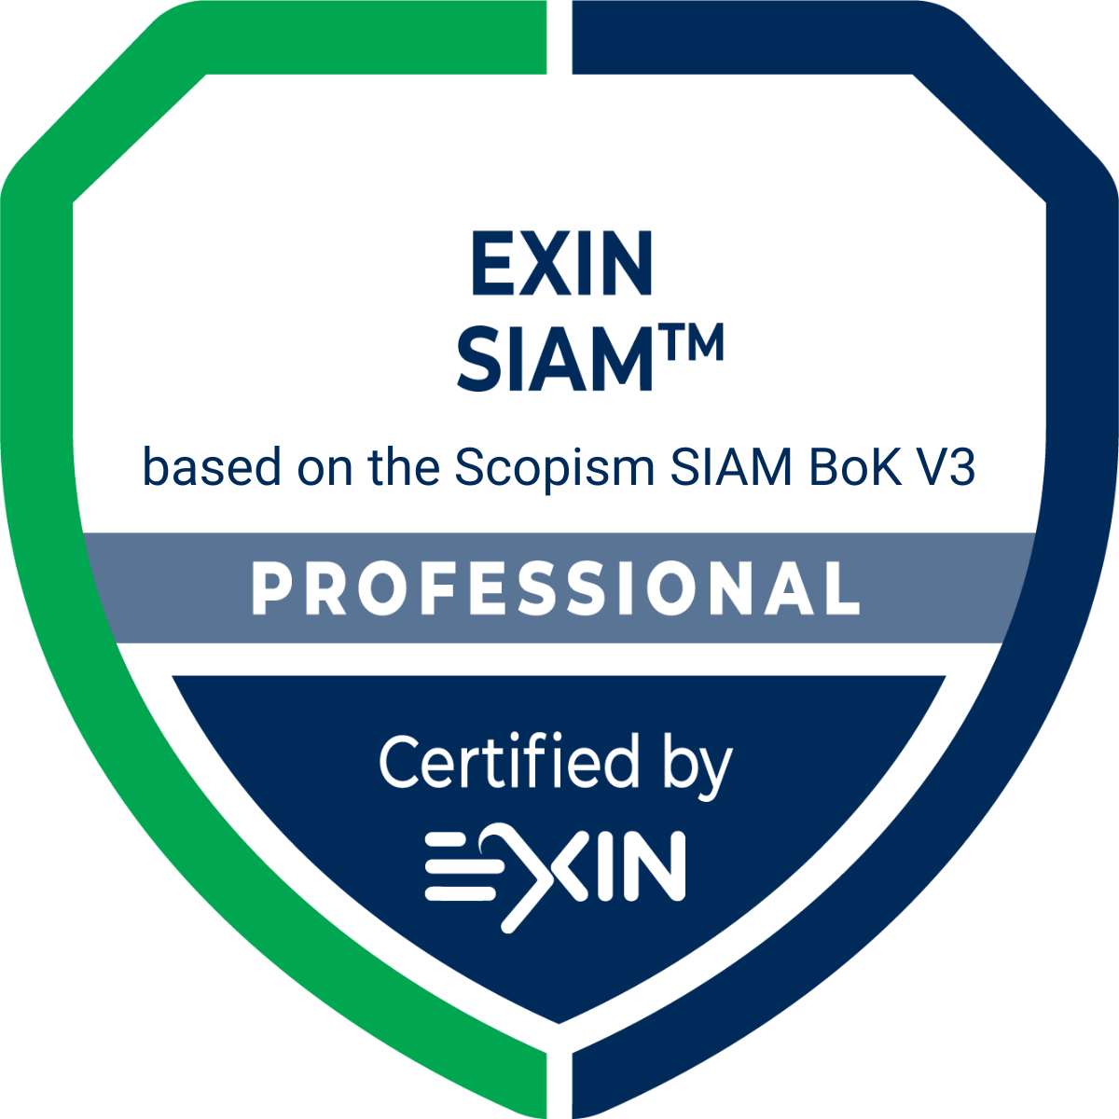

Basic Training Material
202606

Slide 2

Copyright © EXIN Holding B.V. 2026. All rights reserved.
EXIN® is a registered trademark of EXIN.
SIAM™ is a registered trademark of EXIN.
EXIN SIAM™ Professional based on the Scopism SIAM BoK V3 is based on the Scopism SIAM Body of Knowledge.
No part of this publication may be reproduced, stored, utilized or transmitted in any form or by any means, electronic, mechanical, or otherwise, without the prior written permission from EXIN.

Slide 3
Welcome to the Basic Training Material (BTM)
These slides contain basic presentation material to prepare students for the EXIN SIAM™ Professional Bridge based on the Scopism SIAM BoK V3 examination. They may be used as a basis for an accredited training.
The BTM refers to all exam specifications and basic concepts of this module.
Some trainer notes may be included.
A good training requires examples of practical experience, deepening of exam specifications and basic concepts, exercises, elaborating subjects of special interest to the audience.
In case of a minimal training duration, candidates are expected to study the literature. (Compare training duration with study load in Preparation Guide)
The order in which the subjects are presented, follow the order of the exam specifications.
This BTM is not a complete set of courseware. In order to become accredited, you will need to enhance and enrich this material.
When using this BTM, your organization will still need to go through the normal accreditation procedure at EXIN. You can find the accreditation requirements in the Accreditation Manual.
This BTM is a service for training providers, no rights can be derived from it.
Please note that this BTM cannot be sold commercially. ATOs are allowed to use these materials for the sole purpose of developing their own full courseware to be used in EXIN accredited training. They may not create other commercial products and services based on this file without permission from EXIN. When parts of it are used in another context the source must be referenced and the EXIN copyright statement added.

Slide 4
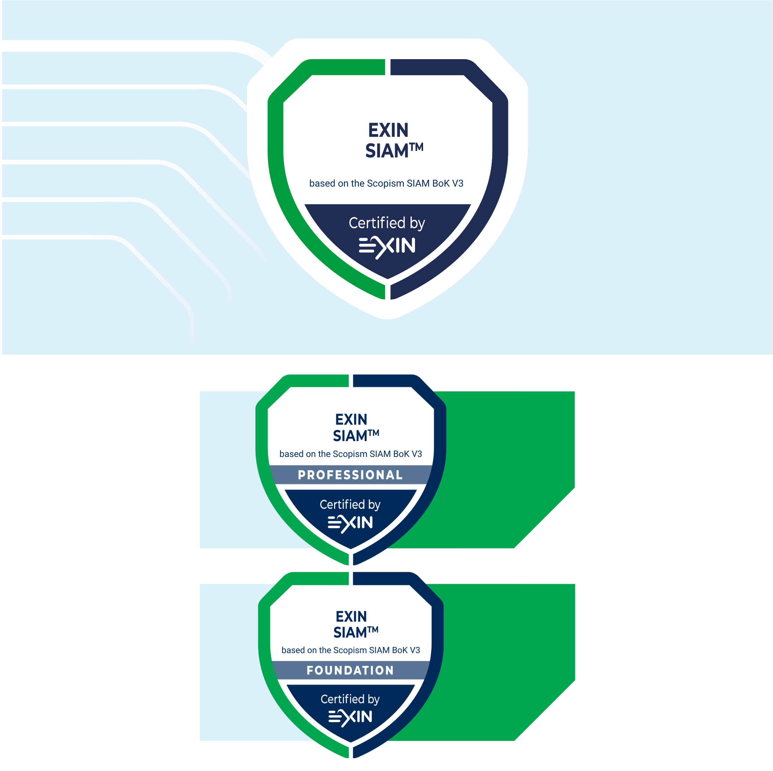

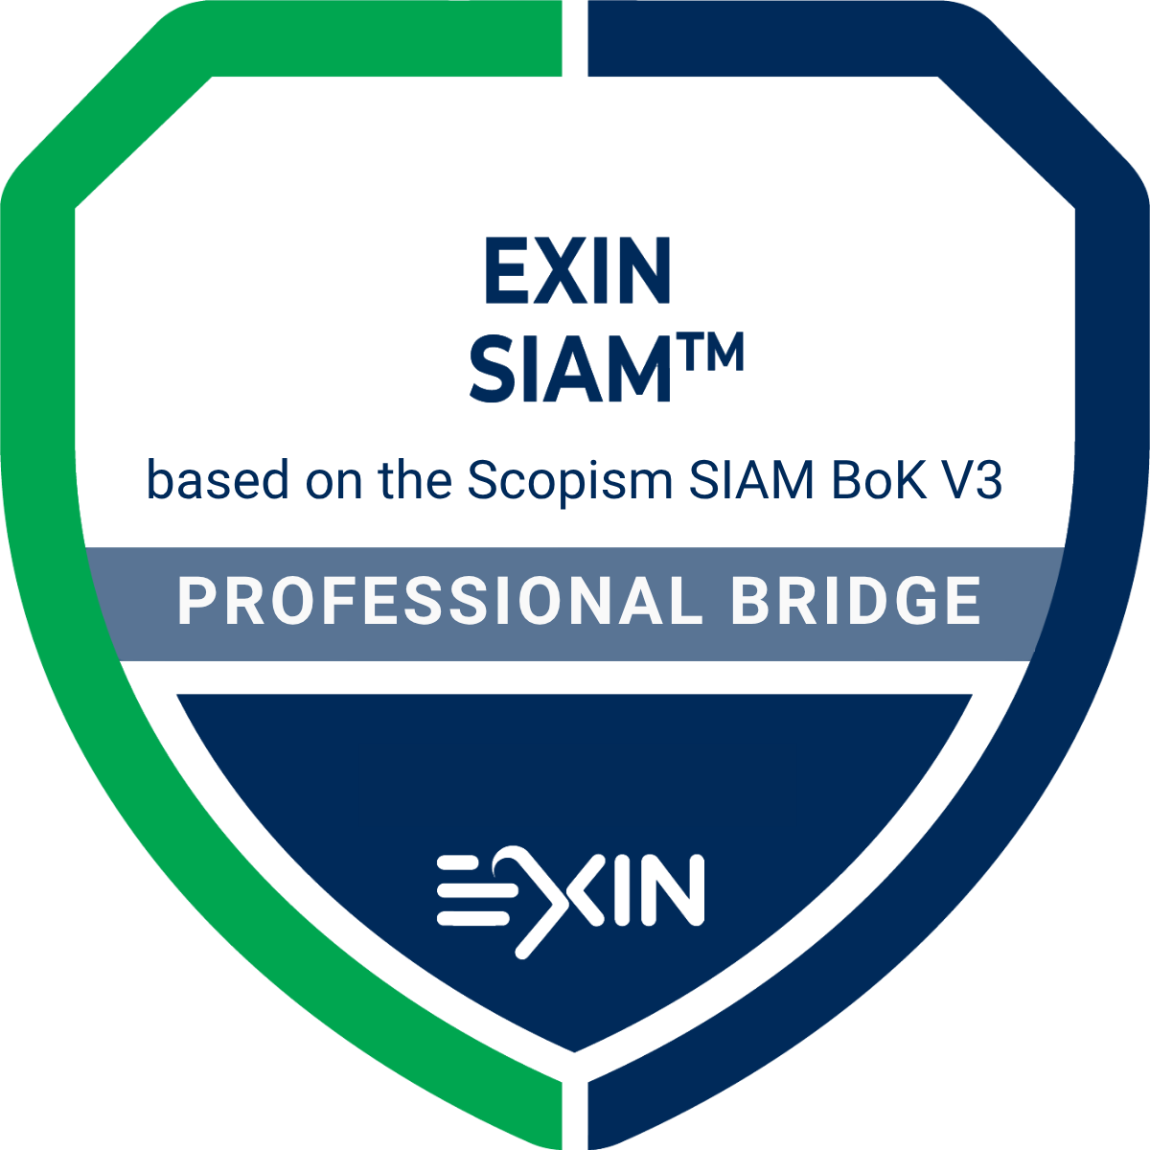

Program Overview
Notes:
Modules
EXIN SIAM™ is a layered program. The two modules are:
EXIN SIAM™ Foundation based on the Scopism SIAM BoK V3
EXIN SIAM™ Professional based on the Scopism SIAM BoK V3
The bridge modules exists to bridge from the earlier versions of EXIN SIAM™ Foundation and EXIN SIAM™ Professional to the current version.

Slide 5
Training schedule
Discovery & Strategy
Plan & Build
Implement
Run & Improve
Notes:
This slide shows the high-level exam requirements and forms the backbone for a training agenda.

Slide 6
Course objectives and target group
EXIN SIAM™ Professional Bridge based on the Scopism SIAM BoK V3 certification confirms that the professional is up to date on applying SIAM best practices according to the Scopism SIAM BoK V3, including the ability to perform activities in the four stages of the SIAM roadmap, manage multiple service providers and integrate them seamlessly to provide a single business-facing IT organization.
This certification is aimed at professionals who already hold a SIAM™ Professional certification under a previous version of the SIAM BoK, who wish to update their knowledge and prove that they can apply the latest and newest best practices in SIAM.
Notes:
The target group includes, but is not limited to:
organizational change managers
business relationship managers
contract managers
service architects
project managers
service managers and practitioners
SIAM consultants

Slide 7
Requirements for certification
Successful completion of a previous EXIN SIAM™ Professional exam.
Successful completion of the EXIN SIAM™ Professional based on the Scopism SIAM BoK V3 exam.

Slide 8
Basic concepts
The list of Basic Concepts in the student notes below will be considered understood for the exam
The student is advised to research and understand the concepts
Notes:
Agile
agile retrospective
balanced scorecard
benchmark
board
business case
business-as-usual
capability
capability assessment
capital expenditure (CAPEX)
cloud services
code of conduct
collaboration agreement
commodity service
conflict of interest
contract
contract management
cross-functional team
customer organization
dashboard
data room
early life support (ELS)
ecosystem
enterprise architecture
environment
escalation
external service provider
externally sourced service integrator
framework
function
governance
governance board
governance framework
governance model
greenfield
hybrid service integrator
incumbent
insourcing
intelligent client function
interim operating model
internal service provider
internally sourced service integrator
ISO/IEC 20000
key performance indicator (KPI)
Lean (systems) thinking
lead supplier service integrator
offboarding
onboarding
operational expenditure (OPEX)
operational level agreement (OLA)
organizational change management (OCM)
outcome
output
outsourcing
performance management and reporting framework
practice
prime vendor
process
process forum
process manager
process model
process owner
RACI (Responsible, Accountable, Consulting, Informed)
request for change (RFC)
responsibility
retained capabilities
risk
roadmap
Scrum
service
service assets
service consumer
service credits
service definition
service element
service grouping
service improvement plan (SIP)
Service Integration and Management (SIAM)
service integrator
service management
service manager
service model
service orchestration
service outcomes
service owner
service provider
shadow IT
SIAM governance lead
SIAM layers
SIAM model
SIAM operational lead
SIAM structure
skills map
sourcing
stakeholder
stakeholder map
strategy
structural element
supplier
tooling strategy
town hall meeting
transformation
transition
trust-based approach
visual management
war room approach
Waterfall
watermelon effect (watermelon reporting)
working group

Slide 9
Examination details
Examination type: | Multiple-choice questions
Number of questions: | 20
Pass mark: | 65% (13/20 questions)
Open book: | No. The exam is based on a case study. This case study is provided as an appendix to the exam.
Notes: | No
Electronic equipment/aides permitted: | No
Exam duration: | 45 minutes
The Rules and Regulations for EXIN’s examinations apply to this exam.

Slide 10
Exam literature
Simon Dorst, Michelle Major-Goldsmith, Claire Agutter et al.
  SIAM Professional Body of Knowledge
  November 2025
  Freely available on https://www.scopism.com/free-downloads/.
EXIN
  EXIN SIAM™ Professional – Case Study
  EXIN (2026)
  Go to www.exin.com. Click on 'Professionals' and then on 'Certifications' to find the certification. The free download can be found under 'Required reading'.

Slide 11
Additional literature
Scopism Limited
  SIAM Foundation Body of Knowledge
  November 2025
  Freely available on https://www.scopism.com/free-downloads/.
ISO/IEC
  ISO/IEC 20000-14:2023 (EN)
  Switzerland, ISO, 2023
  As a result of the increased importance of SIAM, ISO/IEC published part 14 of ISO/IEC 20000: Guidance on the application of Service Integration and Management to ISO/IEC 20000-1. This is not exam literature.

Slide 12
Added Value SIAM BoK V3 (compared to previous versions)
Collaboration, not just cooperation
Ecosystem, not just environment
Operating model
End-to-end value delivery
Strategic alignment
Create value
Importance of community
End-to-end view
Break down complexity
Be flexible, resilient, adaptive
Manage risks effectively
Measure end-to-end performance
Notes:
This slide highlights the biggest shift in the new SIAM Body of Knowledge: the move from managing suppliers and services individually to managing an ecosystem that creates value together.
The first change is the increased focus on collaboration rather than cooperation. Cooperation means organizations work alongside each other, often pursuing their own objectives. Collaboration goes further. It means working together toward shared outcomes and creating value for the customer organization. This also strengthens the connection between SIAM and business strategy, because everyone is focused on achieving common goals rather than optimizing their own part of the service.
The second change is the move from thinking about the environment to thinking about the ecosystem. An environment is simply the context in which organizations operate. An ecosystem is a community of customers, providers, integrators, functions, and processes that work together to deliver value. This encourages a broader perspective and a stronger end-to-end view of services and outcomes.
The third change is the positioning of SIAM as an operating model. SIAM is no longer viewed solely as a way to coordinate suppliers. It becomes the way the organization structures and manages complex service delivery. By breaking complexity into manageable components, organizations become more flexible when responding to change, more resilient when dealing with disruption, and more adaptive as business needs evolve.
Finally, there is a stronger emphasis on end-to-end value delivery. Success is no longer measured only by the performance of individual providers. The focus is on managing risks across the ecosystem and understanding whether the complete service is delivering value to the customer. This requires end-to-end performance measurement, visibility across provider boundaries, and accountability for overall outcomes.
Taken together, these changes show how SIAM has evolved from a supplier management approach into a collaborative operating model focused on delivering business value through an integrated ecosystem.

Slide 13
Added Value SIAM BoK V3 Professional (compared to previous versions)
More emphasis: strategic planning using the SIAM business case and better alignment with overall business goals and strategy
New SIAM models, including SIAM-as-a-Service and continuous development
Added content on SIAM-aware contracting and alignment
More practical guidance on ways of working to support value delivery
Notes:
The updated version of the SIAM BoK has more emphasis on how to approach strategic planning and the creation of a SIAM business case. This helps to ensure better alignment with overall business goals and strategy, set value expectations, and aid in getting commitment from top management.
Specific content on SIAM-aware contracting to aid in taking a holistic, ecosystem approach to contracting. This should help enable integration across providers, foster collaboration, and align all parties with the customer organization’s objectives.
The new version of the BoK includes specific content on emerging models, such as SIAM as a Service and continuous delivery. These help facilitate decision-making regarding which SIAM model is best suited to the organization.
Additional techniques for areas such as capability assessment, designing an effective measurement framework, readiness validation, improving processes, and managing underperformance are listed in the BoK. These provide practical guidance on key areas of a SIAM model implementation.

Slide 14
BoK V3 in one overview
Discovery & Strategy
Operating model
Business case
Success factors
Governance
Clear accountability
Performance oversight
Governance balance
Plan & Build
Collaboration
Contracting
Tooling & sourcing
Run & Improve
Integration
Measurement
Provider improvement
Effective control
Ecosystem design
Continuous improvement
Business alignment

Slide 15
1. Discovery & Strategy

Slide 16
1.1 key elements of a SIAM strategy

Slide 17
Related changes in the SIAM Foundation BoK for:
1.1 key elements of a SIAM strategy
Stronger strategic alignment
SIAM positioned as an operating model, not just an integration model
More guidance on linking SIAM to business strategy
Expanded approaches for building a business case
More flexible adoption
Multiple roadmap routes to SIAM
SIAM-as-a-Service introduced as a sourcing option
Continuous Delivery considered as part of the SIAM strategy
Greater focus on sustaining success
Clearer critical success factors
Continual discovery and readiness validation
More emphasis on gaining and maintaining executive buy-in
Key shift
From implementing SIAM to strategically adopting and sustaining SIAM.
Notes:
This section shows one of the biggest shifts in the new Body of Knowledge.
In earlier versions, SIAM was often introduced as a way to coordinate multiple suppliers. The focus was on integration and governance. In BoK V3, SIAM is positioned much more strongly as an operating model that helps the organization achieve business outcomes.
This is why we see much more content around strategy. The question is no longer simply "How do we implement SIAM?" but rather "Why do we need SIAM, and how does it support our business goals?"
The roadmap guidance has also matured. Instead of assuming every organization follows the same journey, the new guidance recognizes that organizations have different starting points and different strategic objectives. As a result, there are multiple routes to SIAM adoption.
Another important addition is SIAM-as-a-Service. Rather than building all SIAM capabilities internally, organizations may choose to consume SIAM capabilities from an external provider. The same applies to Continuous Delivery, which reflects modern, fast-moving digital environments where services evolve continuously rather than through large projects.
Finally, the BoK places more emphasis on ensuring success. Building a strong business case, securing executive sponsorship, and continually validating readiness are now seen as critical activities rather than optional extras.
The overall message is clear: SIAM should be treated as a long-term business capability, not simply as an implementation project.

Slide 18
1.1.1 Interpret strategic drivers for SIAM
Issues for the customer organization:
No clear end-to-end view of services
  Disaggregated service with no clear accountability
  Duplication of activities for the management of providers
Service provider silo landscape
  Complex legal and regulatory landscape
  Poor collaboration and conflicts between providers
  Fragmented processes, tools and working methods
Notes:
Literature: A, Chapter 2.1

Slide 19
1.1.1 Interpret strategic drivers for SIAM
Strategic drivers for the customer organization:
Service satisfaction
Service landscape
Operational efficiencies
External drivers
Commercial drivers
Notes:
Literature: A, Chapter 2.1

Slide 20
1.1.2 Select an appropriate SIAM strategy
Strategy
  Helps an organization to coordinate and plan activities
  Covers many areas
    E.g.: vision, objectives, targets, reason for change, benefits, costs, timeline, stages, risks, options
  Includes strategic drivers
Vision for SIAM
Strategic planning for SIAM (4 key steps)
Notes:
Literature: A, Chapter 2.1

Slide 21
1.1.2 Select an appropriate SIAM strategy
Scope (and starting point) is the customer organization
  Retained capabilities, elements of the service integrator layer, and potentially one or more internal service providers
  Capability and capacity to manage sourcing
  Strengths and weaknesses of all parties involved
  Internal and external influencing factors
Notes:
Literature: A, Chapter 2.1, 2.2

Slide 22
1.1.3 Illustrate how to gain and maintain buy-in to a SIAM strategy
Communicating the strategy
  Strategic communication
    E.g. business case, strategy document, direct communication
  Counteract passivity
Notes:
Literature: A, Chapter 2.1

Slide 23
1.1.3 Illustrate how to gain and maintain buy-in to a SIAM strategy
Stakeholders
  Map stakeholders
  Define their characteristics
  Consider their perspective
  Give them a place in the strategy
  Create awareness
  Gain support
Notes:
Literature: A, Chapter 2.1

Slide 24
1.1.3 Illustrate how to gain and maintain buy-in to a SIAM strategy
Managing a strategy
A strategy must be
  Practical and achievable
  Providing focus
  Seen to deliver change
  Regularly reviewed
  Changed if necessary
Notes:
Literature: A, Chapter 2.1

Slide 25
1.1.4 Describe the content of the business case and the transition project for SIAM
Components of the (outline) business case
  Strategy
  Services
  Outline SIAM model
    E.g.: principles and policies, governance framework, etc.
  Current operating model
  Benefits expectation
  Costs
  Plan (high level)
  Risks
  Critical success factors
    E.g.: well-conceived strategy and design, process management, partnership with IT, impartiality, boundaries, etc.
  Analysis (to support the plan)
Notes:
Literature: A, Chapter 2.1, 2.3, 2.6

Slide 26
1.1.5 Interpret the principles and policies for roles and responsibilities
Scope
  Customer organization
  Retained capabilities
  Service integrator
  Service providers
Starting point
  Skills framework
Notes:
Literature: A, Chapter 2.1, 2.5

Slide 27
1.1.5 Interpret the principles and policies for roles and responsibilities
Principles for roles & responsibilities
Support of goals, objectives, and vision
Relevant
Complete
Distinguishes the different parties
Service integrator is the lead role
Integration and collaboration
All SIAM stages and model aspects covered
Includes existing contracts
Clarity
Use of a skills framework
Inclusive
  i.e. covers all types of services, all types of staff (old, new)
Segregation of duties
Auditable
Notes:
Literature: A, Chapter 2.1, 2.5

Slide 28
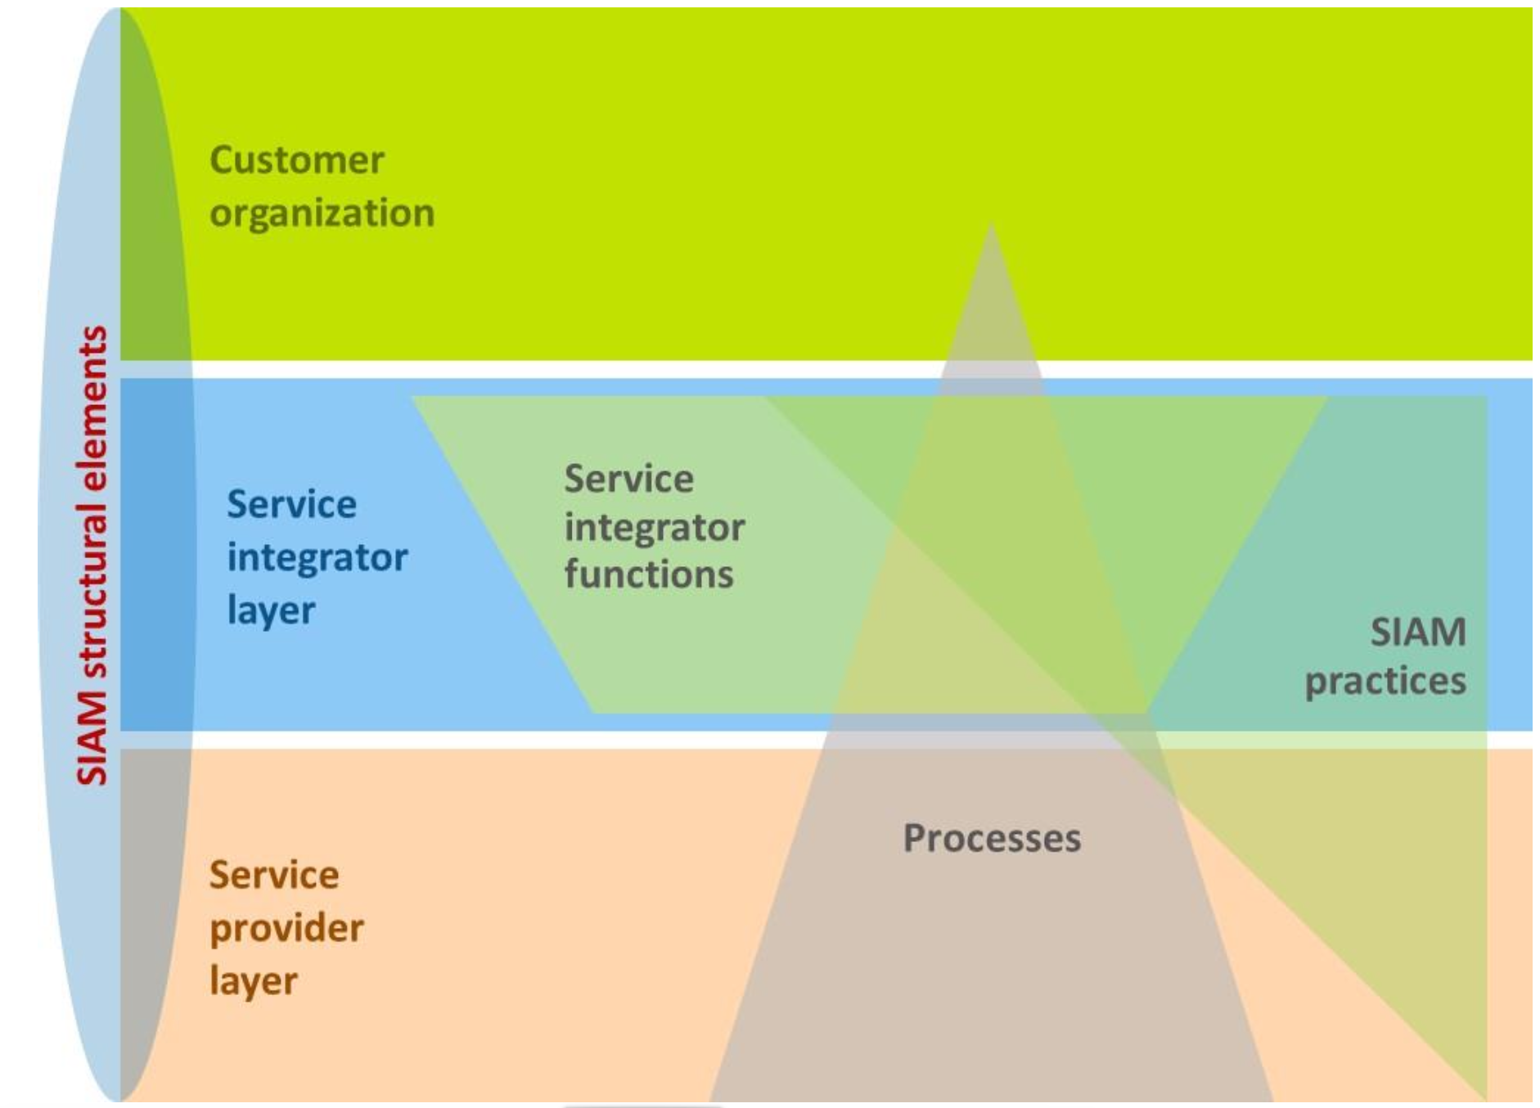
1.1.6 Differentiate critical success factors for SIAM
Well-conceived SIAM strategy
Appropriate design of the SIAM model
Managing process outcomes, not activities
SIAM as strategic enabler
Being conceived as impartial
Clear boundaries of responsibility
Clearly defined governance model
Confidence in the competence of the service integrator
Trusted relationships
Clear and well-defined service agreements
Good management information
Notes:
Literature: A, Chapter 2.1, 2.6

Slide 29
1.3 elements of a SIAM governance framework

Slide 30
Related changes in the SIAM Foundation BoK for:
1.3 elements of a SIAM governance framework
More practical governance
More guidance on governance balance
Clearer accountability
More detailed governance roles
Improved monitoring
Readiness validation introduced
Focus on avoiding governance sprawl
Greater emphasis on conflict-of-interest management
Better distinction between Process Owners and Process Managers
Ecosystem-wide governance perspective
Expanded performance monitoring approaches
Stronger connection between governance and value delivery
Key shift
From governance structures to governance effectiveness.
Notes:
Governance is another area that has become significantly more practical.
In earlier SIAM guidance, governance often focused on structures, committees, and reporting lines. While those remain important, the new BoK is more interested in whether governance actually works.
One major addition is the concept of "just enough governance”. Too little governance creates risk and confusion. Too much governance slows decision-making and creates unnecessary bureaucracy. The goal is to find the right balance.
The new guidance also discusses governance sprawl. As SIAM ecosystems grow, organizations can accidentally create too many meetings, boards, and reporting layers. This can make governance a burden rather than an enabler.
Another important theme is accountability. The distinction between Process Owners and Process Managers is now clearer. A Process Owner is accountable for the overall effectiveness of a process, while a Process Manager focuses on its day-to-day operation.
The governance perspective has also expanded from individual organizations to the entire ecosystem. Governance decisions should support collaboration and value creation across all parties, not just internal objectives.
The key takeaway is that governance should help the ecosystem perform better, not simply provide oversight.

Slide 31
1.3.1 Interpret the characteristics of governance in a SIAM ecosystem
Governance in a SIAM ecosystem
  Consequences of poor governance
  Three layers
  Governance practices
  Three key aspects
Governance enablers
  E.g. COBIT: seven categories of enablers
Governance requirements
  Strategic
  Tactical
  Operational
Governance framework
Notes:
Literature: A, Chapter 2.4
In a SIAM ecosystem, governance and management operates at three layers:
Strategic
Tactical
Operational
Governance practices involve:
Clear accountability
Fairness to all parties
Ethical practices
Openness and transparency
Procedures to prevent conflicts of interest.
SIAM governance focuses on three key aspects:
Ensuring alignment between the customer organization’s current and future business needs and the SIAM strategy
Ensuring that the SIAM strategy and SIAM model are planned and implemented successfully
Ensuring that the SIAM model is managed, operated and improved in a controlled and collaborative manner, in compliance with both internal policies and external legislation.
See also chapter 2.4.1 for consequences of poor governance practices.

Slide 32
1.3.1 Interpret the characteristics of governance in a SIAM ecosystem
Ownership of controls
  Customer organization is central
  Assisted by retained capabilities / service integrator
Notes:
Literature: A, Chapter 2.4

Slide 33
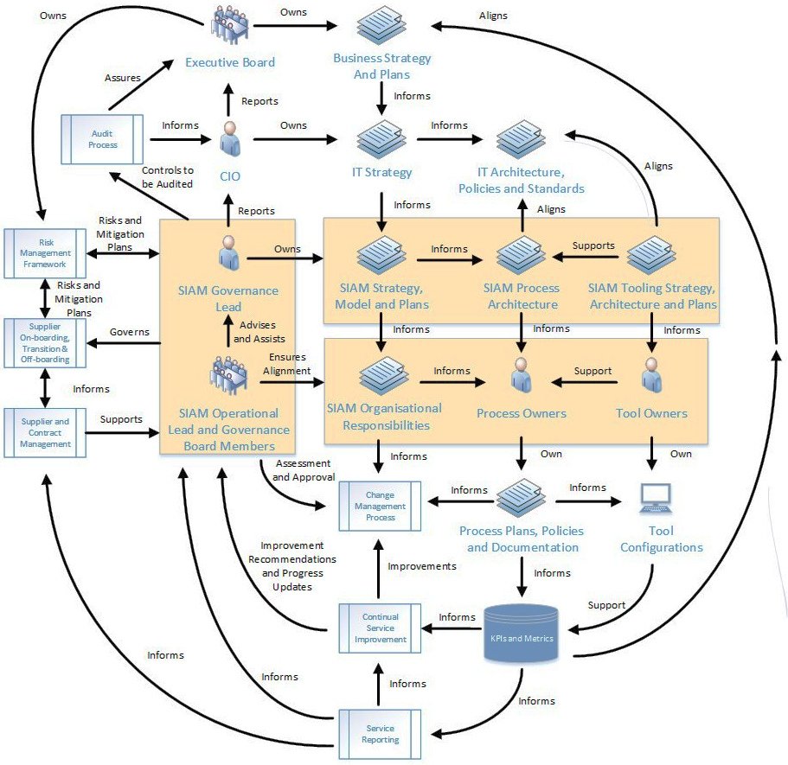
1.3.1 Interpret the characteristics of governance in a SIAM ecosystem
Notes:
Literature: A, Chapter 2.4

Slide 34
1.3.2 Differentiate SIAM governance roles
SIAM ‘project’ governance role
  Project governance is the management framework within which project decisions are made.
SIAM governance roles
  SIAM governance lead role
  SIAM operational lead role
  Process owner roles
  Governance boards
Notes:
Literature: A, Chapter 2.3.3, 2.4
Also see chapters 5.1, 5.2 (SIAM structural elements)

Slide 35
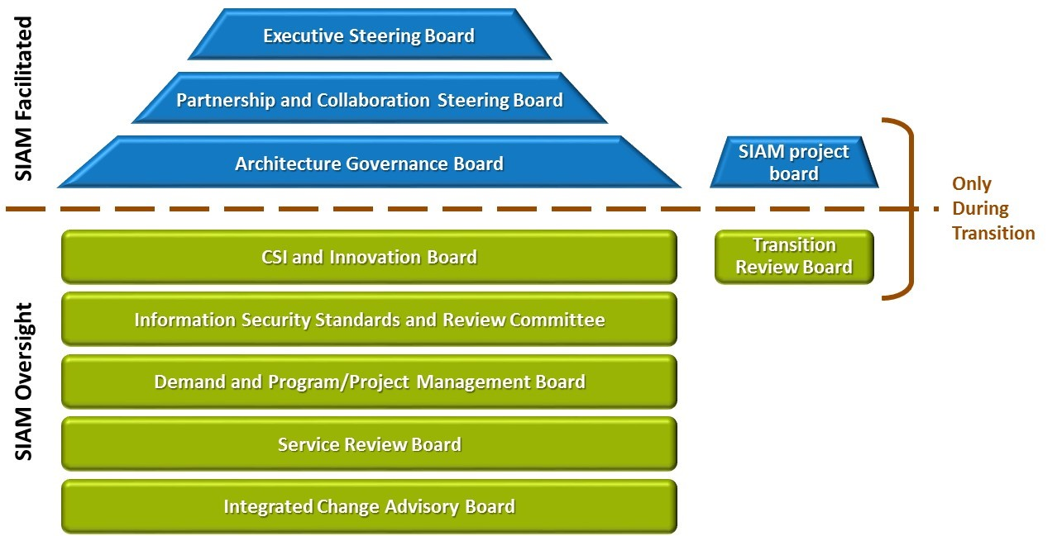
1.3.2 Differentiate SIAM governance roles
Notes:
Literature: A, Chapter 2.3.3, 2.4
Also see chapters 5.1, 5.2 (SIAM structural elements)

Slide 36
1.3.2 Differentiate SIAM governance roles
Governance boards
  Structural element
  MECE design
  Different types
  Executive steering board in detail
    Responsibilities (remit)
    Composition
    Focus areas
    Policies
    Processes
    Ways of working
    Legal and regulatory responsibilities
    Management and control methods
Notes:
Literature: A, Chapter 2.3.3, 2.4
Also see chapters 5.1, 5.2 (SIAM structural elements)

Slide 37
1.3.3 Choose governance approaches for monitoring and measuring service performance
Two perspectives
  Customer organization
  Service integrator
Key aspects
  Identify service targets
  Design targets and corresponding measures (controls)
Notes:
Literature: A, Chapter 2.3.5, 2.3.6, 2.4
An important part of SIAM governance is being able to monitor, measure and understand how the ecosystem is performing.

Slide 38
1.3.3 Choose governance approaches for monitoring and measuring service performance
Assurance role of governance
  Define policies and procedures
  Define roles and responsibilities
  Select appropriate toolsets
  Allocate resources
  Review metrics and reports
  SMART targets
  Take action (if necessary)
Notes:
Literature: A, Chapter 2.3.5, 2.3.6, 2.4
An important part of SIAM governance is being able to monitor, measure and understand how the ecosystem is performing.

Slide 39
1.3.3 Choose governance approaches for monitoring and measuring service performance
People considerations
  Stakeholder perspectives
    Business strategy, direction and priorities
    Technology trends
    Current (internal) staff
    Existing contracts
  Reduction of the impact of challenges - approaches
  Considering incumbent staff displacement
    Specific situations, e.g. movement of services to an external party, etc.
    Specific aspects, e.g. legal, social responsibility, retention of key staff, etc.
Notes:
Literature: A, Chapter 2.3.5, 2.3.6, 2.4
See also chapter 2.5.2

Slide 40
1.3.3 Choose governance approaches for monitoring and measuring service performance
The SIAM project is not formally established at this stage.
  Scope (at this stage) is the SIAM project itself
    The time and costs of the SIAM project
    The quantified benefits of the SIAM project
  Definition of a high-level SIAM scorecard
Notes:
Literature: A, Chapter 2.3.5, 2.3.6, 2.4

Slide 41
2. Plan & Build

Slide 42
2.1 design a detailed SIAM model

Slide 43
Related changes in the SIAM Foundation BoK for:
2.1 design a detailed SIAM model
Better structural choices
More guidance on governance balance ("just enough governance")
Ecosystem thinking
More detailed governance roles
More practical decision-making
Data rooms
Benchmarking
Focus on avoiding governance sprawl
Greater emphasis on conflict-of-interest management
Better distinction between Process Owners and Process Managers
Ecosystem-wide governance perspective
Tooling and integration strategies
RAG reporting and measurement approaches
Contracting guidance
Key shift
From managing suppliers to designing the ecosystem.
Notes:
This section contains many of the practical additions to the Body of Knowledge.
The first area is SIAM structure design. Earlier versions described the common SIAM structures, but BoK V3 provides more guidance on when and why to choose a particular model. This includes different hybrid approaches and guidance on where the Service Integrator should be positioned.
The concept of service design has also expanded. The BoK now distinguishes between customer-facing services and supporting services. This helps organizations better understand what they are managing and where value is created.
Another important addition is the idea of integration levels. Not every provider needs the same level of involvement within the ecosystem. Some may be deeply integrated, while others remain relatively independent. Understanding this helps organizations design more effective operating models.
Collaboration receives much greater attention. Earlier versions often discussed cooperation between suppliers. The new guidance emphasizes collaboration, where providers actively work together toward shared customer outcomes.
This thinking is reflected in SIAM-aware contracting. Traditional contracts often focus on individual supplier performance. SIAM-aware contracts encourage collaboration and shared responsibility across the ecosystem.
The new BoK also introduces practical concepts such as benchmarking, data rooms, tooling strategies, and RAG reporting. These additions help organizations make better decisions during design and implementation.
The overall shift is from understanding the available options to knowing how to choose the right option for a specific organization.

Slide 44
2.1.1 Select an appropriate sourcing approach and SIAM structure
Sourcing approach
  Sourcing the service integrator
  Planning the role of the service desk
    E.g. service desk provision models
SIAM structures (SIAM ecosystem)
  Externally sourced service integrator
  Internally sourced service integrator
  Hybrid service integrator
  Lead supplier as service integrator
Notes:
Literature: A, Chapter 3.2

Slide 45
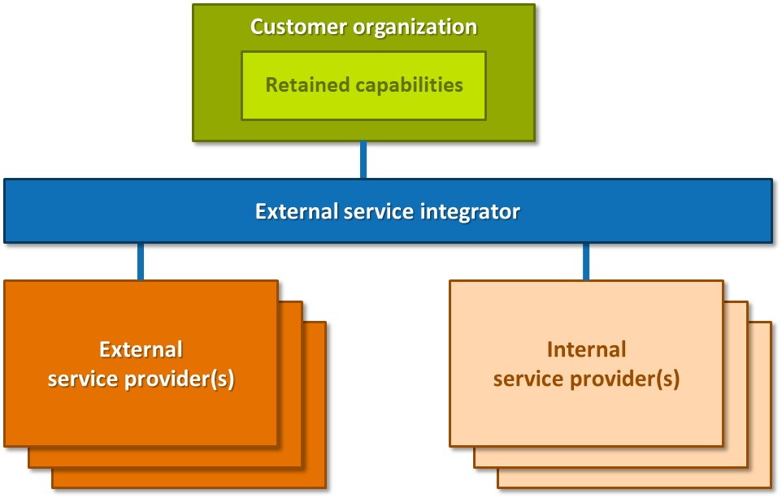
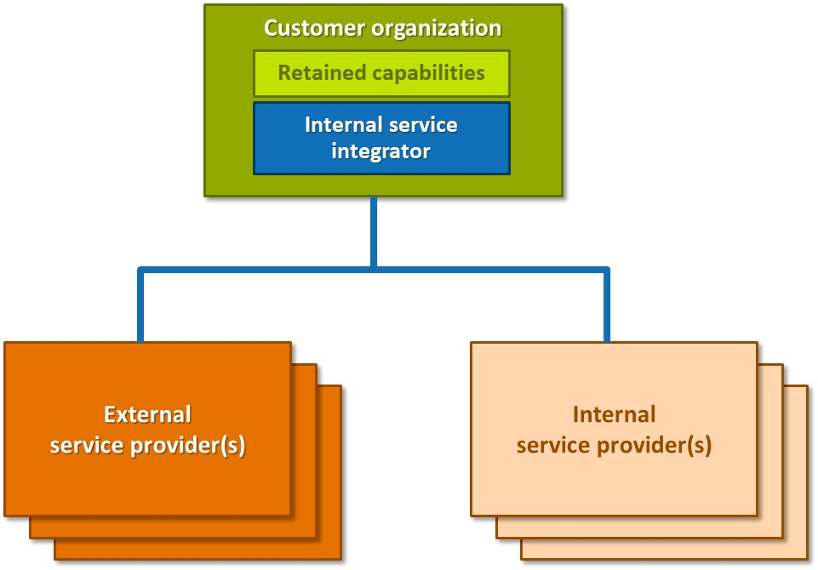
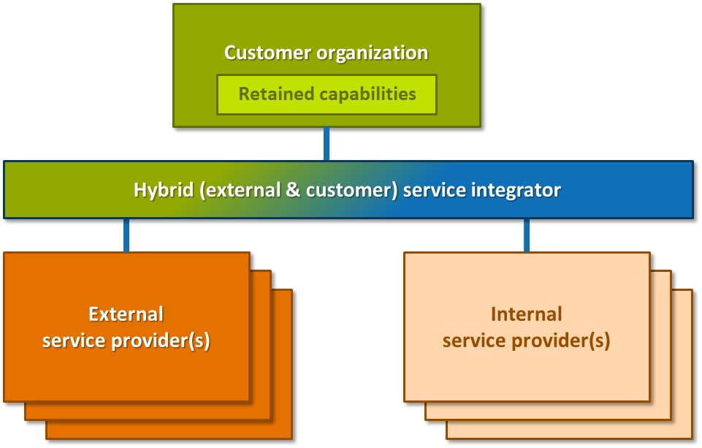
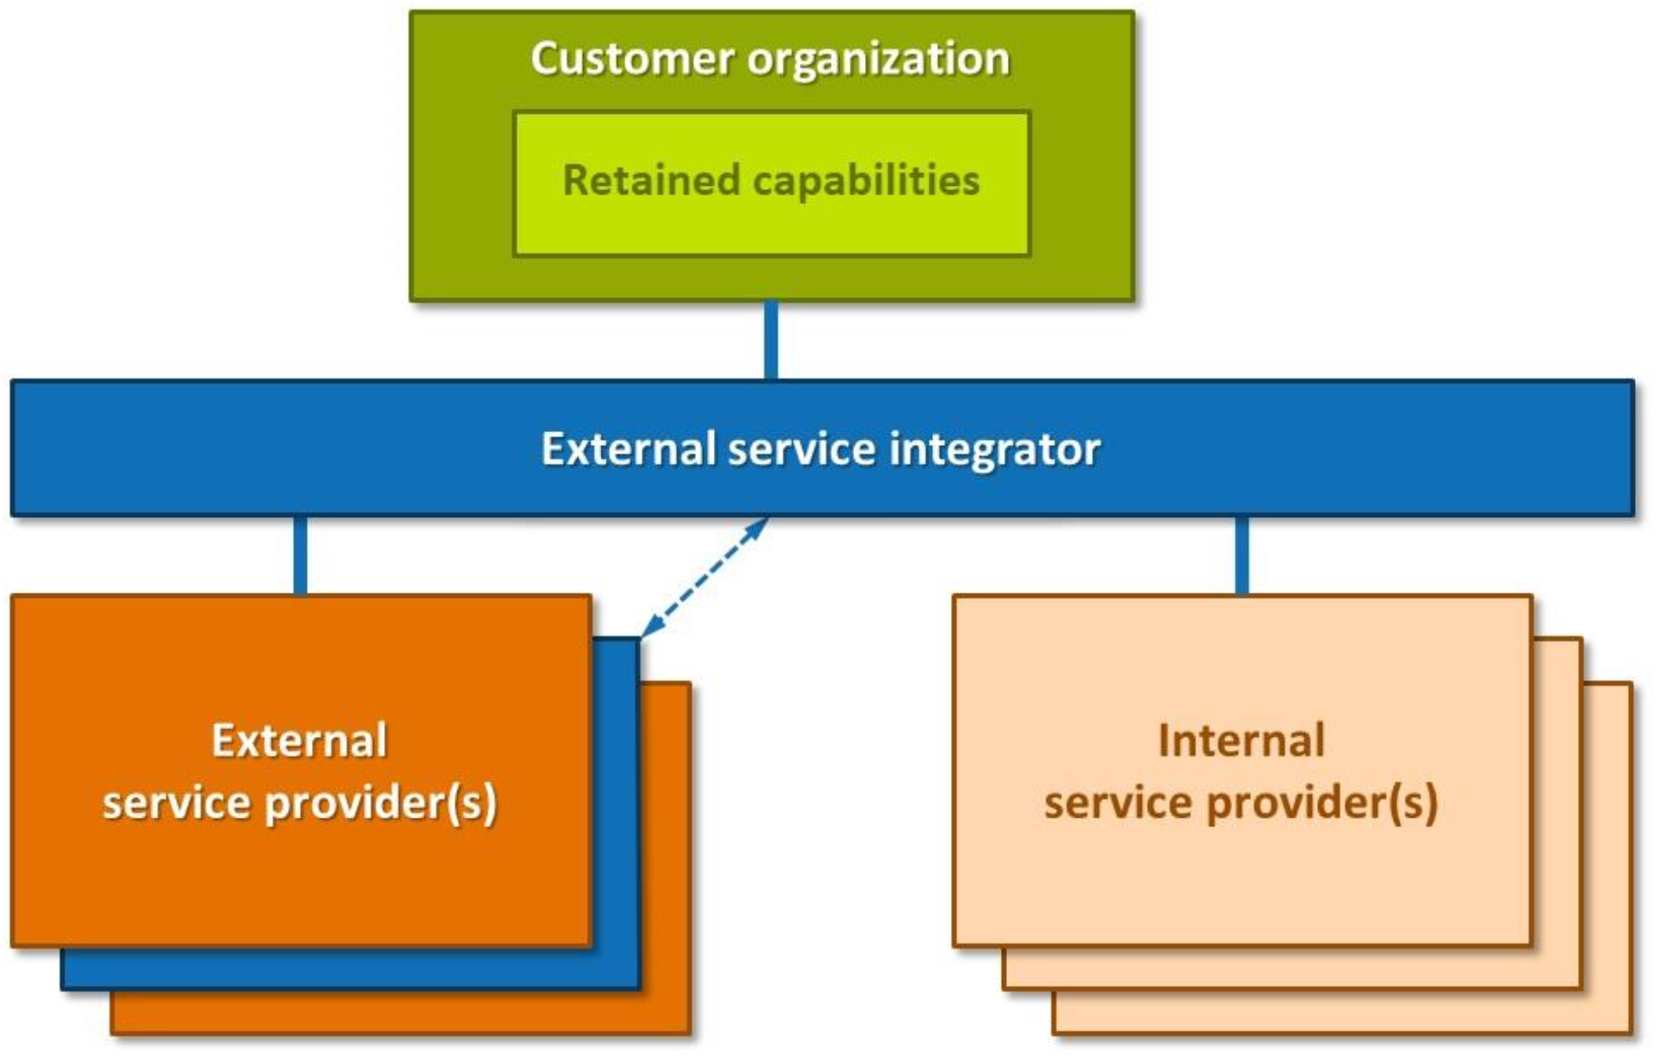
2.1.1 Select an appropriate sourcing approach and SIAM structure
Externally sourced service integrator
Internally sourced service integrator
Hybrid service integrator
Lead supplier as service integrator
Notes:
Literature: A, Chapter 3.2

Slide 46
2.1.2 Analyze contract considerations for SIAM
Purpose and requirements
  Critical for success
  Must address integration
  Must contain detail around acceptable ways of working
  Advantages and risks mature service providers
  Education, skills and experience
  Contract arrangements and management
  Position of the service integrator
Contract structure
  Service integrator contract
  Service provider contract
    E.g. accountability, expectations
Notes:
Literature: A, Chapter 3.2

Slide 47
2.1.2 Analyze contract considerations for SIAM
Service credits
  Purpose
  Characteristics
  Types
  Format
  Breaches
  Legal status
  Capped service credits
Incentives
  Purpose
  Target setting
Notes:
Literature: A, Chapter 3.2

Slide 48
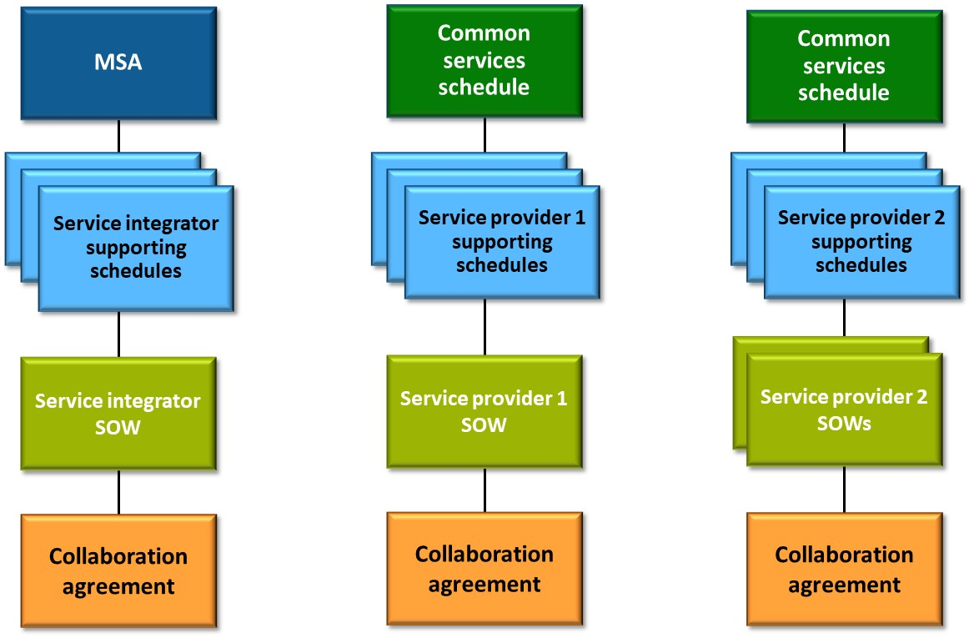
2.1.2 Analyze contract considerations for SIAM
Notes:
Literature: A, Chapter 3.2
Example of generic contract structure

Slide 49
2.1.2 Analyze contract considerations for SIAM
Master Services Agreement (MSA)
Common services schedule
Supporting schedules
Statements of Work (SoWs)
Document that describes interaction between all parties
Three types of collaboration agreements
  Contractual
    Any contracts, e.g. service integrator and service provider contract
  Operational
    E.g. OLA, OLM, OLF
  Process
    In process models
Notes:
Literature: A, Chapter 3.2
Components of contract structure for SIAM
Master Services Agreement (MSA)
Common services schedule
E.g. IP-rights, non-disclosure requirements, force-majeure statements, liabilities and waivers, rights to assign or novate contracts, contract change and termination arrangements, payment terms, contractual dispute process
Supporting schedules
E.g. approach for testing and deploying, security requirements, performance management approach, service management requirements, disaster recovery requirements, service desk requirements, technology refresh requirements, standards
Statements of Work (SoWs)
Document that describes interaction between all parties
E.g. collaboration agreement

Slide 50
2.1.3 Analyze organization-specific service models and process models
Four architectural viewpoints for SIAM
  The organization structure for the retained capabilities
  The process model
  The service model
  The technology model
Notes:
Literature: A, Chapter 3.2
Manage process outcomes, not activities!

Slide 51
2.1.3 Analyze organization-specific service models and process models
Service map considerations
  Service groupings
  Developing the SIAM model
  SIAM transition approach considerations
Notes:
Literature: A, Chapter 3.2
Manage process outcomes, not activities!

Slide 52
2.1.3 Analyze organization-specific service models and process models
Process models
  Process model components
  Useful techniques
    E.g. swim lane process mapping, RACI, etc.
  Integrated process models
  Managing process outcomes and integrating processes
  Operational manual
Notes:
Literature: A, Chapter 3.2
Manage process outcomes, not activities!

Slide 53
2.1.4 Describe detailed roles and responsibilities
Key aspects and considerations
  Function/role to which they report
  Responsibilities and corresponding expectations
  Level of authority to make decisions (acting power)
  Territorial scope: service windows, language and culture, time zones
Capability framework
  Purpose: a set of principles that clearly outlines the expected behaviors and capabilities required of staff to achieve performance
Skills map
  Purpose: sets out all the main employability skills in a way that shows their relationships to each other
Notes:
Literature: A, Chapter 3.2

Slide 54
2.1.5 Select a performance measurement and reporting framework
Must be regularly reviewed
Includes metrics to provide information on
    Does each service provider meet its targets?
    Does each service provider meet its obligations?
    What does the end-to-end delivery of services look like?
Governance of measurement
Should include standards for
  Data classification
  Reporting formats and frequency
User and customer experience should be the focus
Stakeholders
External provider obligations
Notes:
Literature: A, Chapter 3.1, 3.2
Stakeholders
▪ Customer organization
▪ Senior management team
▪ Purchasing and/or finance
▪ Business relationship managers
▪ Management of service provider organizations.
Example obligations include:
▪ Responsibilities of the service delivery manager based on site
▪ Billing to be submitted by the fourth working day of the month
▪ Use and change of subcontractors to be notified to the customer two months in advance and subject to approval
▪ Attendance at and input to a collaboration/innovation forum.

Slide 55
2.1.5 Select a performance measurement and reporting framework
Measurement examples
  SMART key performance indicators (KPIs)
  Performance of processes and process models
  Achievement of service level targets
  System and service performance
  Adherence to contractual and non-contractual responsibilities
  Collaboration
  Customer satisfaction
  Standards, e.g. data classification, reporting formats, reporting frequency
The role of targets
Performance measurement plan
Notes:
Literature: A, Chapter 3.1, 3.2
SMART: Specific, Measurable, Achievable, Relevant, Time-bound

Slide 56
2.1.6 Select a collaboration model
Objectives (examples)
  Coherent end-to-end service delivery
  Positive and effective interchanges between the service providers
  Rapid identification and resolution of inhibitors to performance and service delivery
Considerations
  The SIAM environment and ecosystem are unique
  Cultural aspects of a transition to a SIAM model
  Objective assessment of collaboration
Best practices:
  Coordination mechanisms
  Relationship management
  Collaboration agreements
  Building cooperative teams
  Setting and managing shared goals
Notes:
Literature: A, Chapter 3.2

Slide 57
2.1.7 Analyze the most appropriate tooling strategy and integration methods for a SIAM ecosystem
Tooling strategy
  Tooling strategy and roadmap
  A ‘trust and track’ method of measurement
  Standard integration methods
  Ownership of data and toolsets
  Ease of adding and removing service providers
  Adopting a common data dictionary
Notes:
Literature: A, Chapter 3.2, 3.5
“provide a single source of truth“

Slide 58
2.1.7 Analyze the most appropriate tooling strategy and integration methods for a SIAM ecosystem
Integration recommendations
  Integrated configuration management system (CMS) and associated configuration management databases (CMDBs)
  Contractual clauses
  Common reporting model
  End-to-end measuring
  Central role of the service integrator
  Financial management of multiple service provider contracts
  Collaboration tools
    E.g. digital workplace
  Process harmonization through technology
Notes:
Literature: A, Chapter 3.2, 3.5
“provide a single source of truth“

Slide 59
4. Run & Improve

Slide 60
4.1 operate, Assure and improve a SIAM ecosystem

Slide 61
Related changes in the SIAM Foundation BoK for:
4.1 operate, Assure and improve a SIAM ecosystem
Greater focus on improvement
Capability assessment techniques
Better ecosystem integration
End-to-end process design
More effective measurement
Enhanced reporting approaches
Collaborative culture
Fix First, Discuss Later
Problem management and Lean thinking
Managing under-performing providers
Integration-level thinking
Ecosystem-wide process management
Practical performance management guidance
Audit and compliance support
Shared accountability
Continuous assessment and adaptation
Key shift
From operating services to continuously improving the ecosystem as a means to reach success.
Notes:
The Run & Improve section reflects another important evolution in SIAM thinking.
Earlier guidance focused heavily on operating the ecosystem. The new guidance focuses much more on continuously improving it.
One example is capability assessment. Organizations are encouraged to regularly assess strengths, weaknesses, and improvement opportunities using practical techniques such as RACI models, heat maps, and structured assessments.
The BoK also adds more practical guidance on process improvement. Techniques such as problem management and Lean thinking help organizations identify waste, remove bottlenecks, and improve service outcomes.
Managing under-performing providers is another new area of focus. Rather than waiting for major failures, organizations are encouraged to identify issues early and take corrective action before they affect the wider ecosystem.
Integration is also viewed more holistically. The focus is no longer on individual processes within individual suppliers, but on end-to-end processes that span the entire ecosystem.
Measurement has become more sophisticated as well. The new guidance emphasizes outcome-based measurement, visual reporting, and understanding the health of the ecosystem as a whole rather than simply tracking supplier KPIs.
Finally, the BoK promotes a stronger collaborative culture. The "Fix First, Discuss Later" principle is a good example. The priority should always be restoring service and delivering value to the customer before discussing accountability or contractual responsibilities.
The key message is that successful SIAM organizations do not simply operate their ecosystem—they continually assess, improve, and adapt it.

Slide 62
4.1.1 Analyze structural elements at different levels
Operate governance structural elements
Strategic governance
Operational governance boards
Process forums and working groups
Notes:
Literature: A, Chapter 5.1, 5.2
“The structural elements are intended to provide stability, support and governance of the SIAM ecosystem.” (Literature A)
Also check Literature A, chapter 2.4.6.4 Governance boards (e.g. executive steering committee discussed in detail)

Slide 63
4.1.1 Analyze structural elements at different levels
Strategic governance;
    E.g. executive board
    Executive steering board
    Partnership and collaboration steering board
    Architecture governance board
    Continuous service improvement and innovation board
    Information security standards and review committee
    Demand board
    Service review board
    Integrated change advisory board (ICAB)
  With regard to service providers
    Adopt agreed standards and policies
    Set priorities and approve resources
    Make decisions that are acted upon
    Reward as well as censure
    Adjudicate escalated issues
Notes:
Literature: A, Chapter 5.1, 5.2
“The structural elements are intended to provide stability, support and governance of the SIAM ecosystem.” (Literature A)
Also check Literature A, chapter 2.4.6.4 Governance boards (e.g. executive steering committee discussed in detail)

Slide 64
4.1.1 Analyze structural elements at different levels
Tactical governance boards
Preparation activities, escalation
  Example: service review board
Operational governance boards
  Tools: visual techniques
Notes:
Literature: A, Chapter 5.1, 5.2
“The structural elements are intended to provide stability, support and governance of the SIAM ecosystem.” (Literature A)
Also check Literature A, chapter 2.3.7.4 Governance boards (E.g.: executive steering committee discussed in detail)

Slide 65
4.1.1 Analyze structural elements at different levels
Process forums and working groups
  Central role service integrator
  Aligned to a specific process or practice
  Practicing standard/framework best practices
  Utilizing practices based on Agile & Scrum
  Excluding commercial matters
  Daily or weekly standups using (for example)
    Scrum sprints
    Kanban boards
  Process review action plan
Notes:
Literature: A, Chapter 5.1, 5.2
“The structural elements are intended to provide stability, support and governance of the SIAM ecosystem.” (Literature A)
Also check Literature A, chapter 2.3.7.4 Governance boards (E.g.: executive steering committee discussed in detail)

Slide 66
4.1.2 Select appropriate mechanisms to address issues and improve provider and integrator performance
Key performance indicator (KPI) mapping and service level agreement (SLA) reporting; purpose, types of reporting
  Reporting tools
  Reconciliation between different providers
Differentiation between provider and integrator performance
  Measuring the service integrator
  Imposing service credits
Evolving ways of working
  Through operational management
  Driving improvement and innovation
Notes:
Literature: A, Chapter 5.3, 5.4, 5.6
Carefully selected metrics “help a business determine whether its goals are being achieved,” (Literature A)
The paragraphs discussed here have many references to other parts of the BoK.
Ongoing performance management and improvement; points of reference are key performance indicators and defined service level targets

Slide 67
4.1.2 Select appropriate mechanisms to address issues and improve provider and integrator performance
Ongoing service provider management
  Supplier and Contract Management Information System (SCMIS)
  Daily standups
    i.e. process forums and working groups
  Success factors
  Service provider review
  Adding and removing service providers
  Managing under-performing service providers
  Dispute resolution
  Using collaboration agreements
Notes:
Literature: A, Chapter 5.3, 5.4, 5.6
Carefully selected metrics “help a business determine whether its goals are being achieved,” (Literature A)
The paragraphs discussed here have many references to other parts of the BoK.
Ongoing performance management and improvement; points of reference are key performance indicators and defined service level targets.

Slide 68
4.1.2 Select appropriate mechanisms to address issues and improve provider and integrator performance
Ongoing change management
  Ongoing capability assessment
  Skills mapping
  Ongoing training needs analysis and training plans
  Succession planning
Notes:
Literature: A, Chapter 5.3, 5.4, 5.6

Slide 69

4.1.2 Select appropriate mechanisms to address issues and improve provider and integrator performance
Service-focused reporting
  Focus on value provided to customer organization
  Measuring end-to-end service performance
  Visual management
    Visual controls
Key performance indicator (KPI) aggregation
Address failure due to dependency on another service provider
Notes:
Literature: A, Chapter 5.3, 5.4, 5.6
Aggregated KPIs should:
▪ Focus on results of services and demonstrate the impact of service delivery on business outcomes, not the output of service providers
▪ Provide both qualitative and quantitative measures to provide a balanced view
▪ As much as possible, be objective to minimize subjective interpretation
▪ Be SMART (Specific, Measurable, Achievable, Relevant and Time-bound)
▪ Be appropriate and the total number of KPIs should be limited across the organization (such as approximately three per goal)
▪ Have boundaries. If a service provider does not control all the parts of service performance, then that service provider cannot be held responsible for failure to meet targets.

Slide 70
4.1.2 Select appropriate mechanisms to address issues and improve provider and integrator performance
Trust-based approach to supplier management
  Not based on contracts alone, but on trust
  Facilitates best outcomes and true collaboration
Level of trust may fluctuate due to specific events
  Low, medium & high trust relationships
  On average, the trust level should increase over time
  Events like major incidents, changes and pressure may affect trust level
Trust management cycle
  Define trust
  Understand barriers to achieving trust
  Build the foundation for trust
  Support, maintain and modify the trust environment
Notes:
Literature: A, Chapter 5.3, 5.4, 5.6

Slide 71

4.1.2 Select appropriate mechanisms to address issues and improve provider and integrator performance
Risk and reward mechanisms
  Purpose
  Approach
  Risk/award program attributes
    Collaborative behavior
    Service credits and earn back
    Shared key performance indicators (KPIs)
    Monitoring effects
    Visible results
    Improvement ecosystem
    Knowledge management
Notes:
Literature: A, Chapter 5.3, 5.4, 5.6
The paragraphs discussed here have many references to other parts of Literature A.
For example: chapter 3.2.3.7 Service credits, and chapter 3.2.3.8 Incentives.

Slide 72
4.1.3 Apply audit and compliance mechanisms
Audit and compliance
  Compliance management and audits
  Driving improvements post audit/assessment
    Requirements of external standards
    Holistic audits
    Audit objectives
  Audit reports
    Findings (three parts)
    Structure of the report
  Follow up activities (continual improvement)
    Timescales for actions
Notes:
Literature: A, Chapter 5.5

